Slide 1
Syllabus IHE Groundwater Flow Transient Analytical Solutions
Prof.dr.ir.T.N.Olsthoorn, 2020-2021
tolsthoorn@gmail.com
+31-620440256

Slide 2
Introduction
Objectives
Exercises
Irreversible and reversible transient groundwater phenomenae
Transient one-dimensional flow (cross sections)
Transient flow to wells (axial symmetric flow)

Slide 3
Transient groundwater flow:
Can exist only if some form of storage is available
Without storage pressures would spread at (almost) infinite speed, implying that the flow system would be steady
Every physical system shows at least initially some dynamics in storing energy, momentum or mass and in our case: water
Notice that “storage” can be positive or negative (“retrieval”); mathematically it is the same, just the sign is different

Slide 4
Groundwater systems
Without recharge, a groundwater system gradually drains towards its boundaries. The drainage time is characteristic for that system and can be short or long:
Some groundwater systems react fast; their equilibrium is reached in days to weeks.
Some systems react extremely slowly; it may take hundreds or even thousands of years before an equilibrium is finally reached
For example: Kalahari, drainage takes > 10000 years
Other example: A small parcel between ditches, 2 days

Slide 5
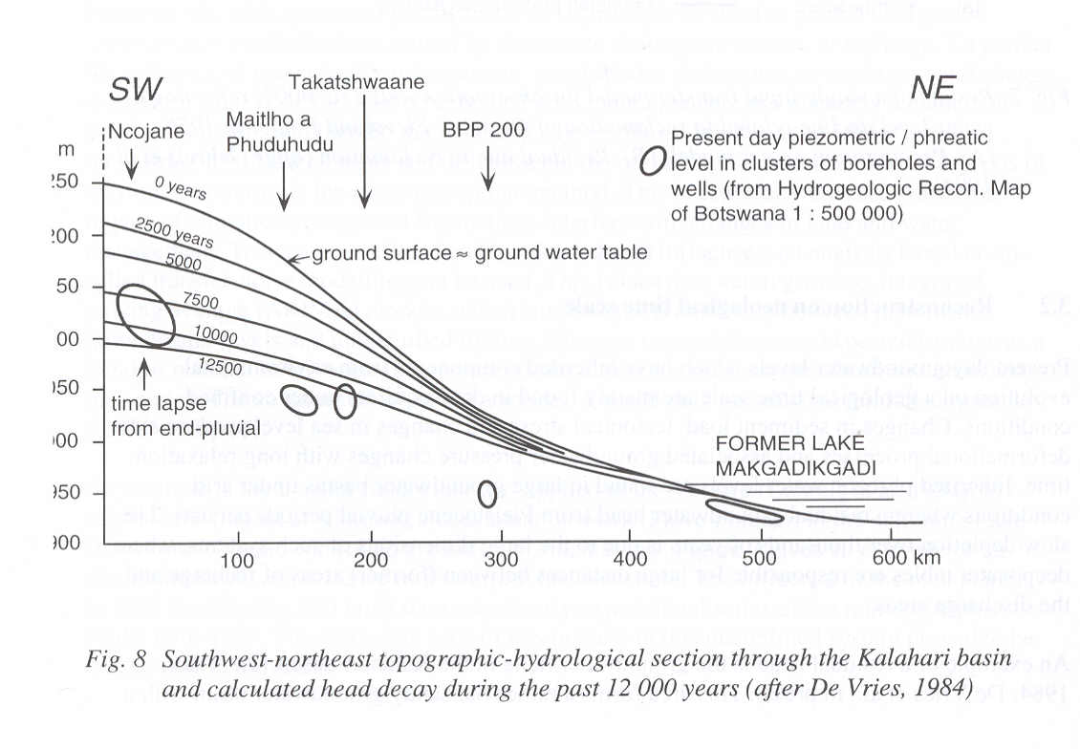
Natural drainage of the Kalahari Desert since previous wet episode

Slide 6
Forms of subsurface water storage
Irreversible storage
Liquefaction
Subsidence (consolidation)
Over-extraction of fresh water causing intrusion and upconing of saltwater in an aquifer (almost irreversible, i.e. may take centuries to restore).
Reversible storage
Water table storage
Elastic storage

Slide 7
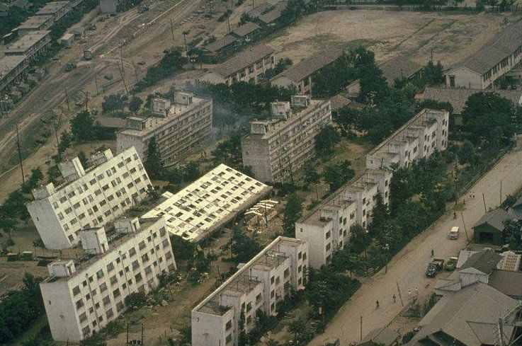
Liquefaction
https://www.scienceworld.ca/resource/liquefaction/

Slide 8
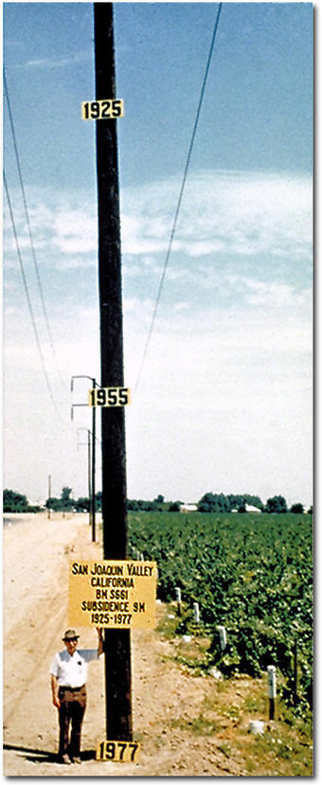
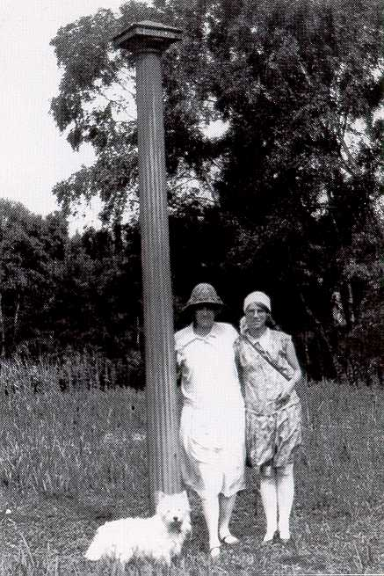
Subsidence

Slide 9
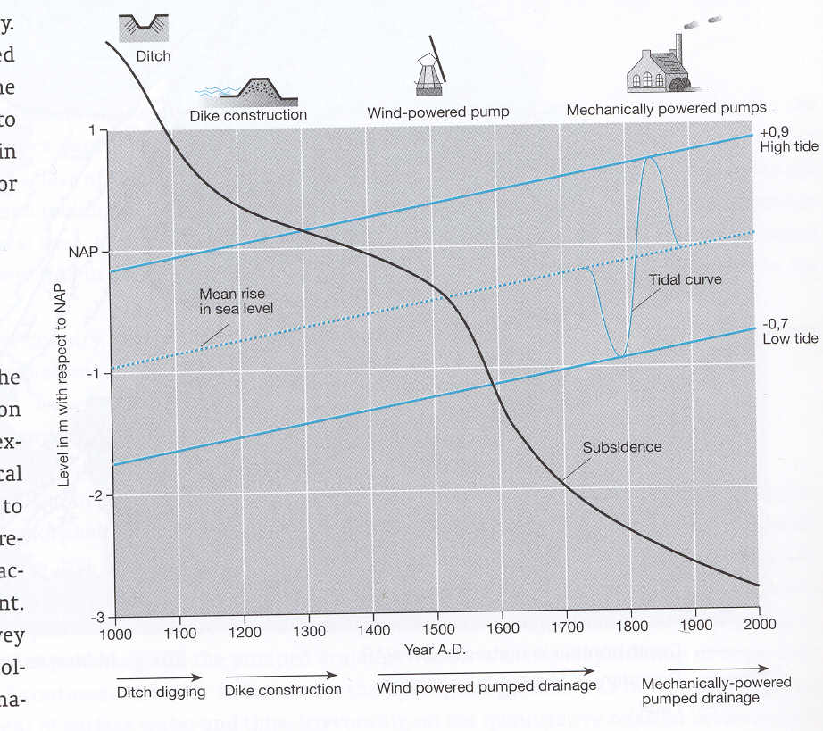

Slide 10
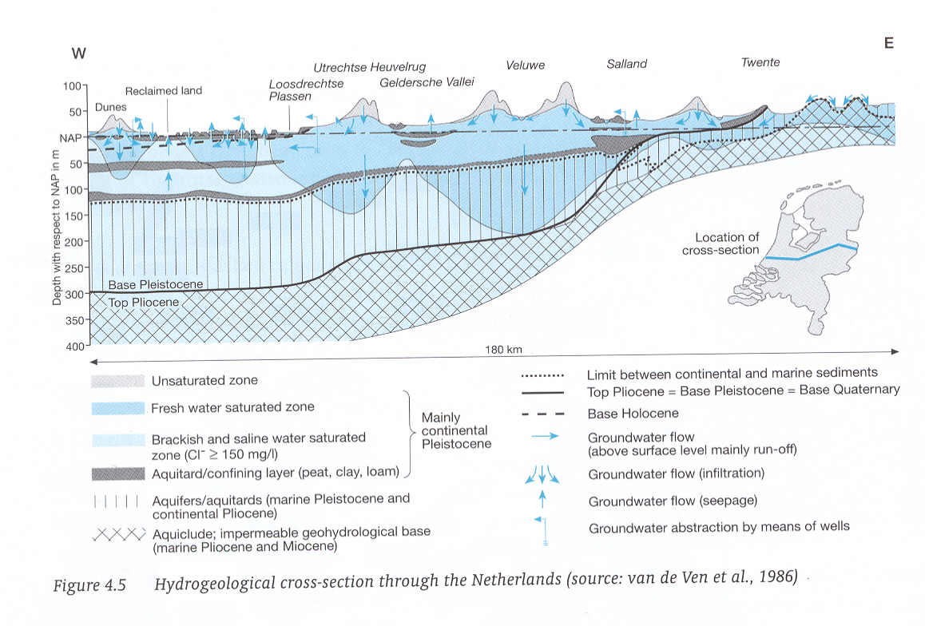
Fresh water floating on salt water

Slide 11
Variations in storage of water in aquifers are possible because
Elastic behavior of water, grains and especially the porous matrix as a whole
Storage of water above the water table in the unsaturated zone (emptying and filling of pores)
Sometimes: compression of gas, e.g. in petroleum engineering or when gas is formed in the subsurface e.g. by biochemical reactions (CH4)

Slide 12
Forms of reversible storage
Water-table / phreatic storage
Elastic storage

Slide 13
Phreatic or water-table storage
Keywords:
Unsaturated zone
pF-curves
Specific yield

Slide 14
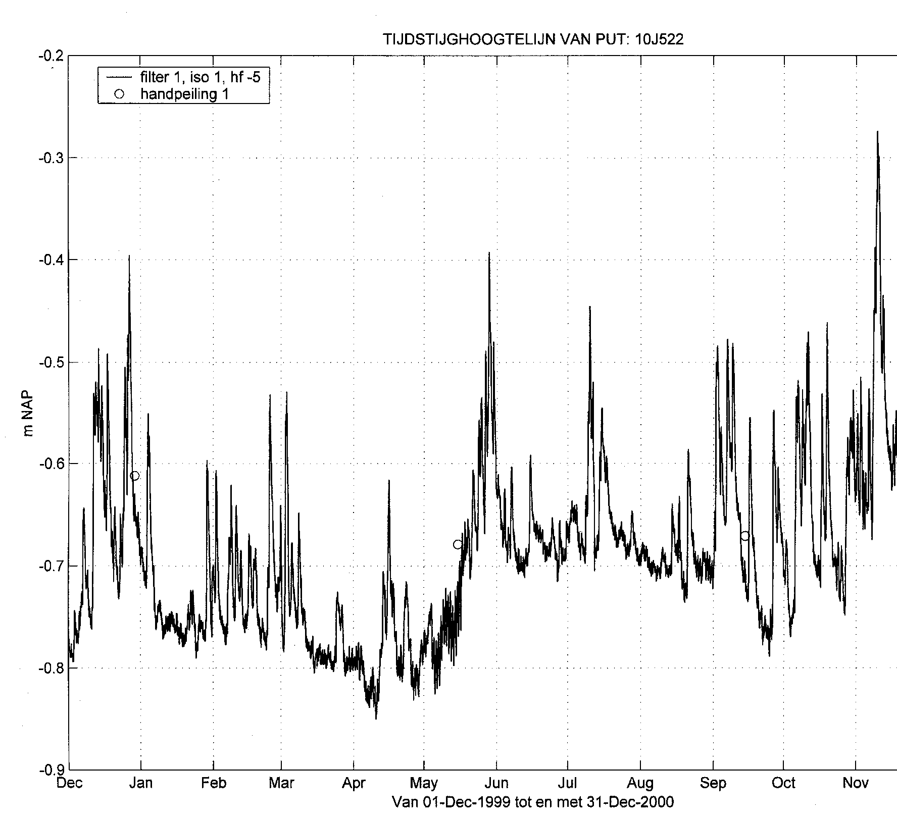
Example of fluctuations of the water table measured in an
Observation well in the dune area south of Zandvoort, The
Netherlands
Line: hourly registration
Circles: hand measurements for verification

Slide 15
Capillarity (as the simplest model of the unsaturated zone)
α
r
R
Meniscus
=
sphere
(
must
be
)
compare
with
half
sphere
h
p
=
−
ρ
gz
c
z

Slide 16
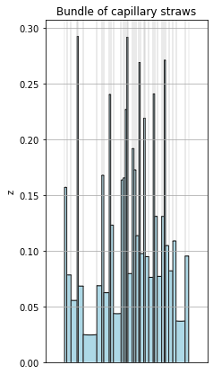
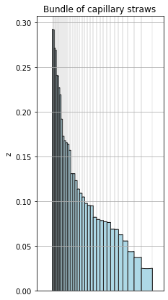
The unsaturated zone may be viewed as a set of tubes (straws) with a
distribution of widths. Capillary rise depends on tube width.

Slide 17
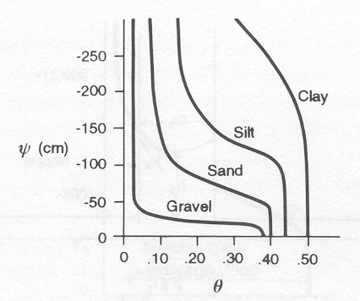
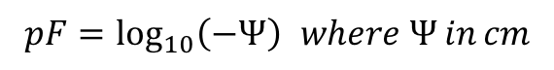
Saturation or pF curves for different materials
$$pF=\log_{10}\left(−Ψ\right) where Ψ in cm$$

Slide 18
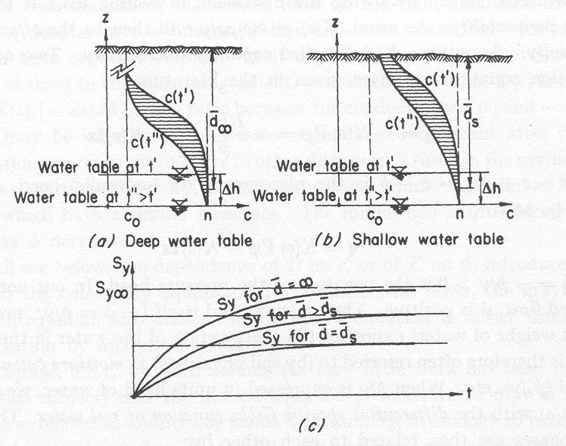
Drainage from the unsaturated zone, deep vs shallow water table
Cut-off moisture
profile
Actually drained

Slide 19
Free gravity drainage leaves some water behind → specific yield

Slide 20
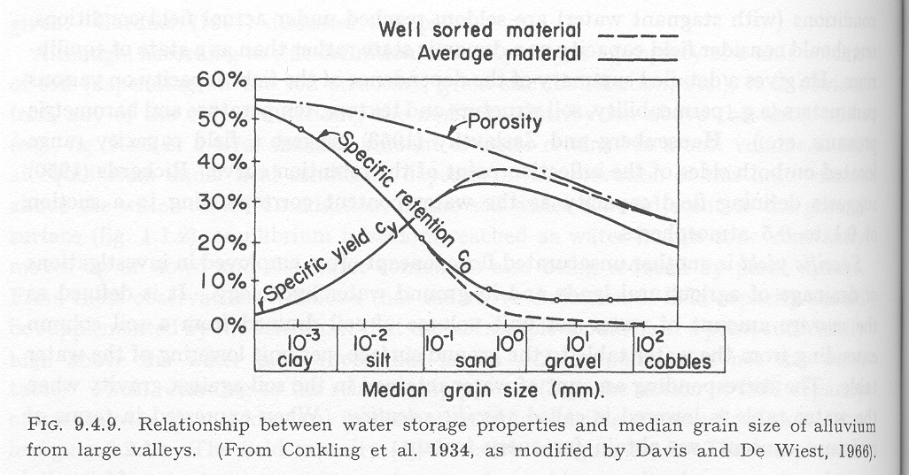
Specific yield vs specific retention. (Porosity tends to be smaller for coarser materials)

Slide 21
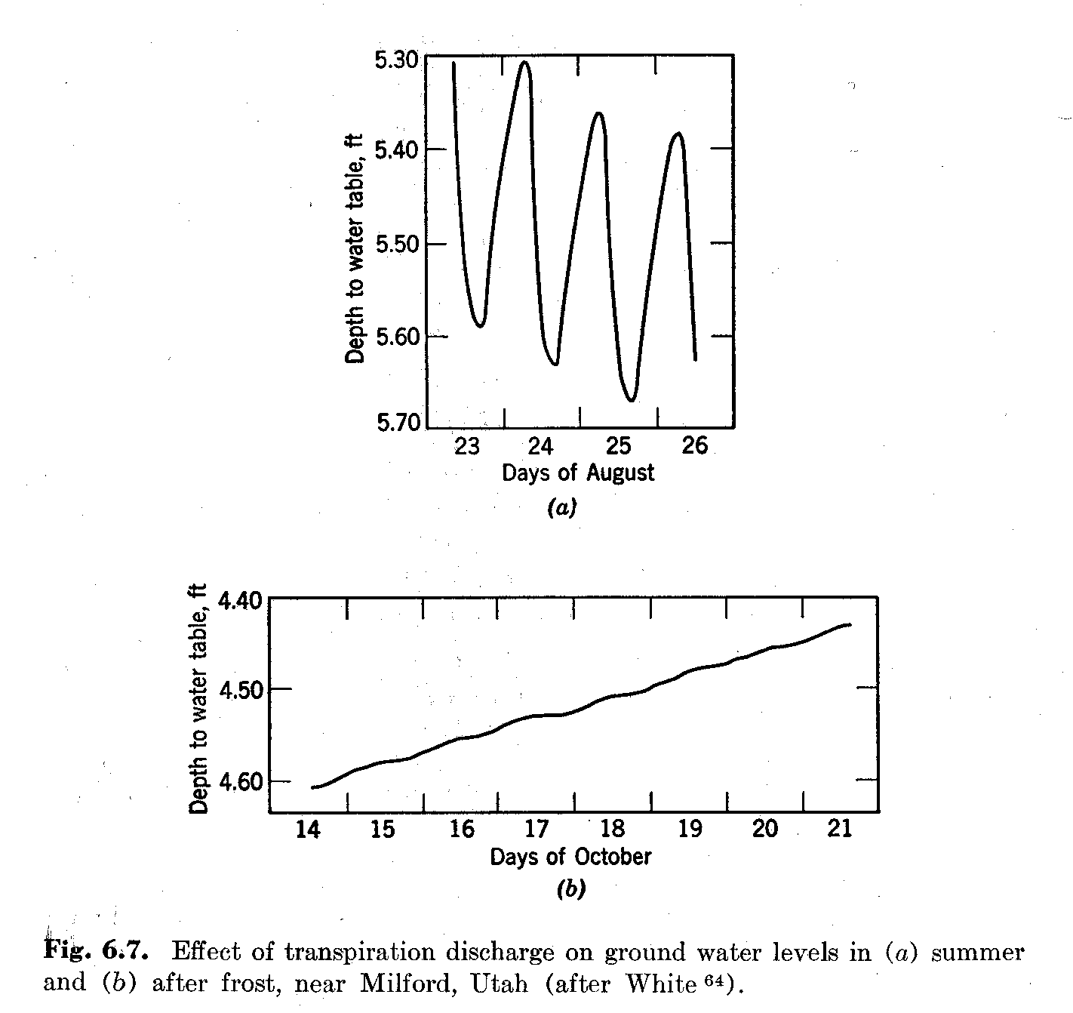
Effect of daily plant transpiration on shallow water table.

Slide 22
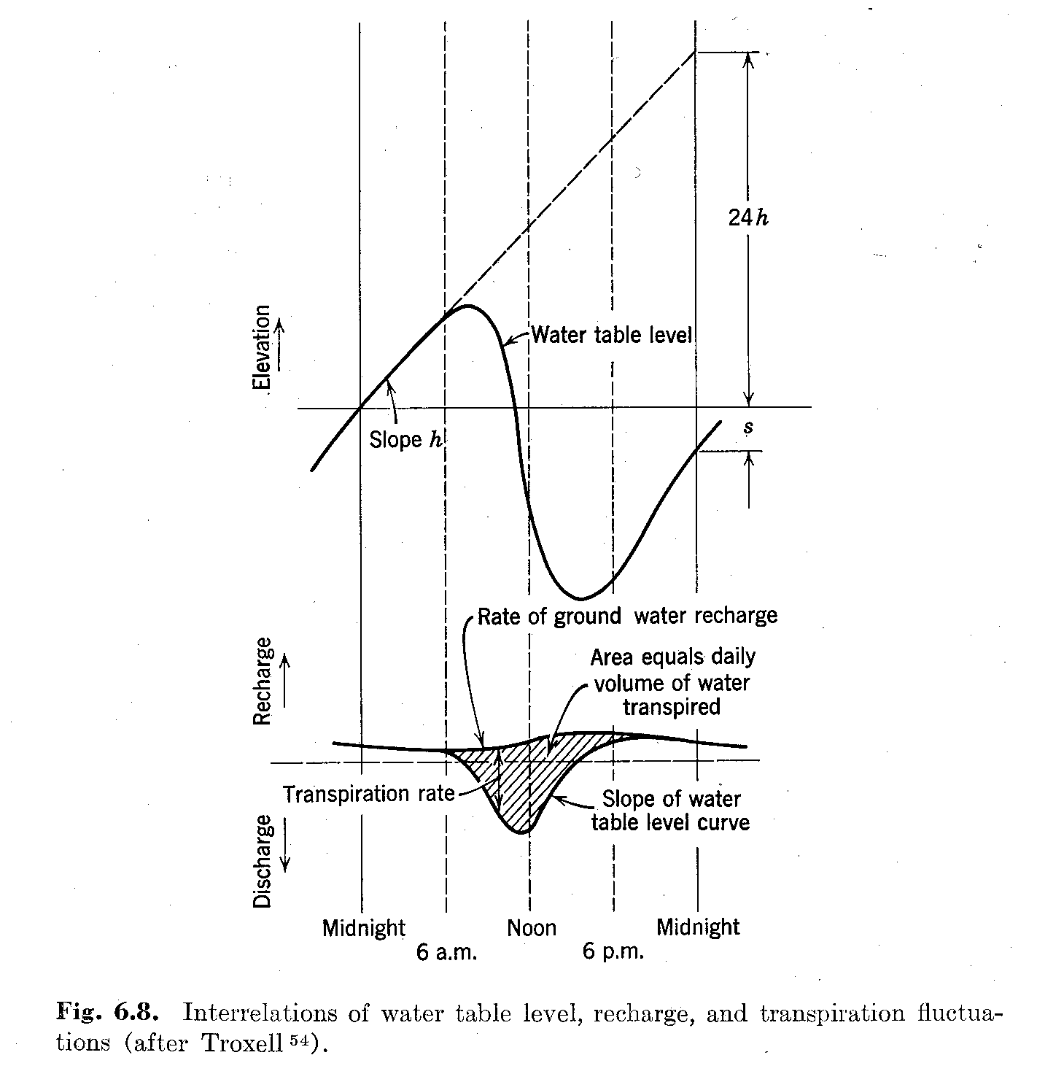
Estimation of transpiration from daily water-table fluctuation
Water table
decline in
24 hours
Trend (no transpiration during the night)
Rate of groundwater
recharge
Water table
decline in
24 hours

Slide 24
Elastic storage (semi)-confined aquifers
Keywords:
Specific (elastic) storage S_{s}
Elastic storage of aquifer S
Loading efficiency
Barometric efficiency
(Earth tide)

Slide 25
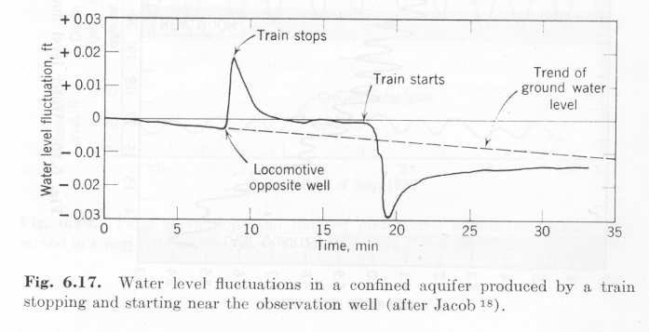
First –ever registered confined groundwater head fluctuation under varying load (i.e. a train) at ground surface

Slide 26
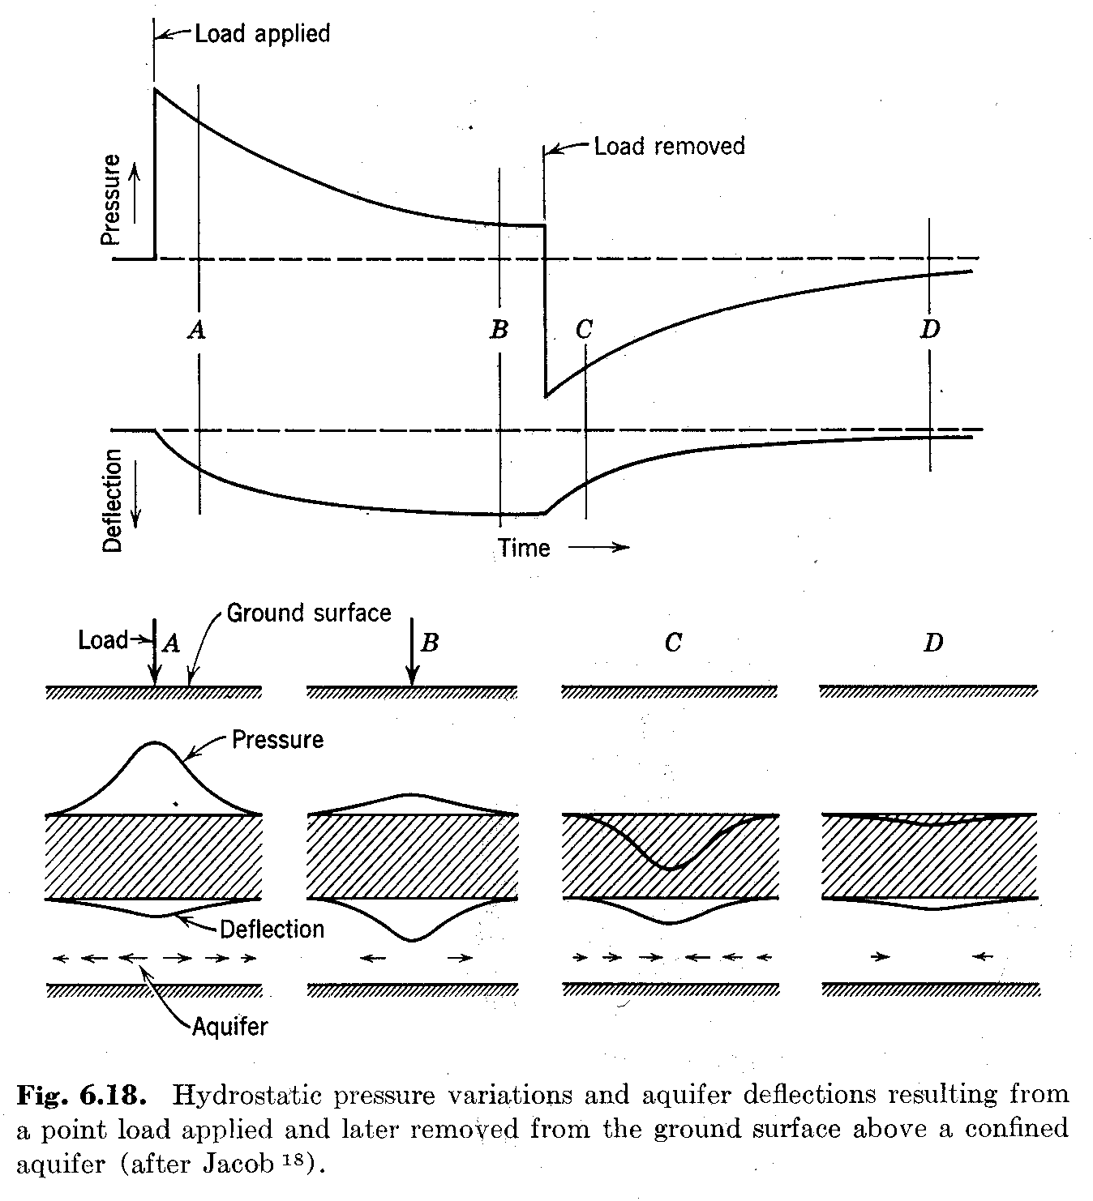
Explanation of the ”train effect”, i.e. of the effect of a varying load at ground surface on the head in a (semi)-confined aquifer.

Slide 27
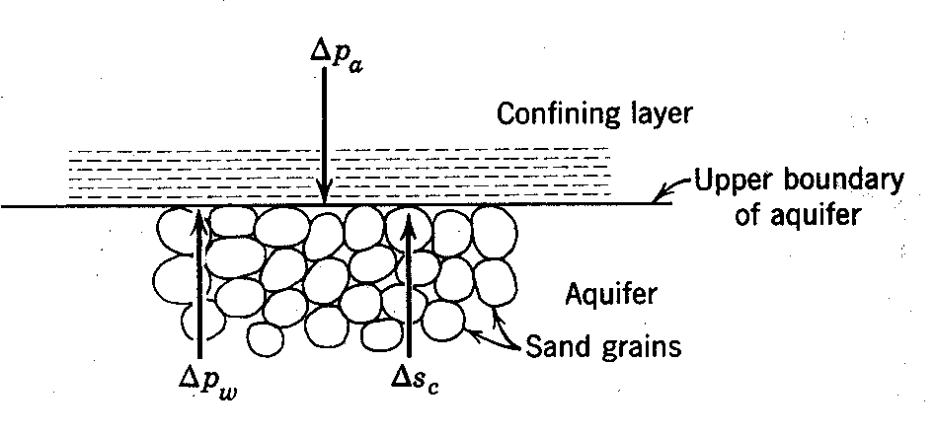
Alternative way of explaining the same thing, focusing on the changes of the water pressure and that at the porous matrix.

Slide 28
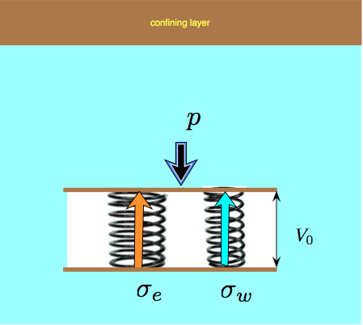
Explaining elastic storage/compression conceptually using two springs (one water, one porous matrix)

Slide 29
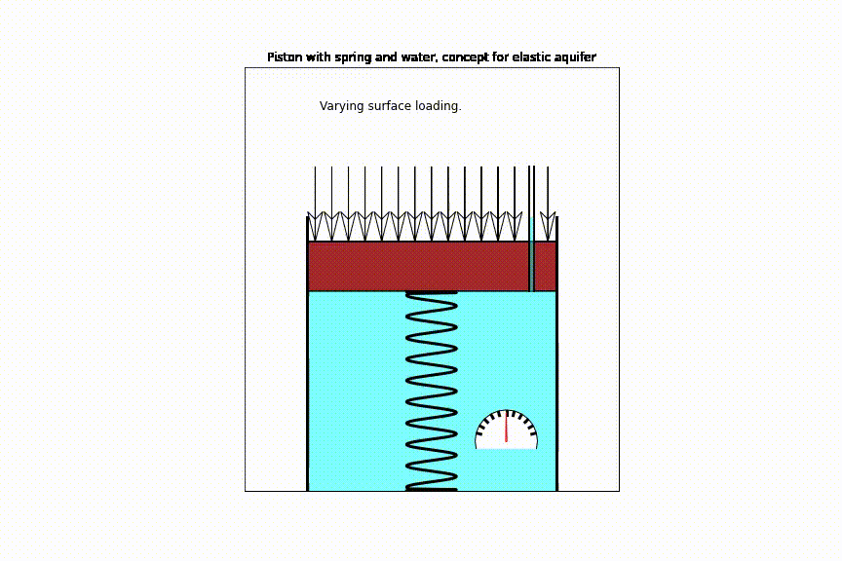

Slide 30
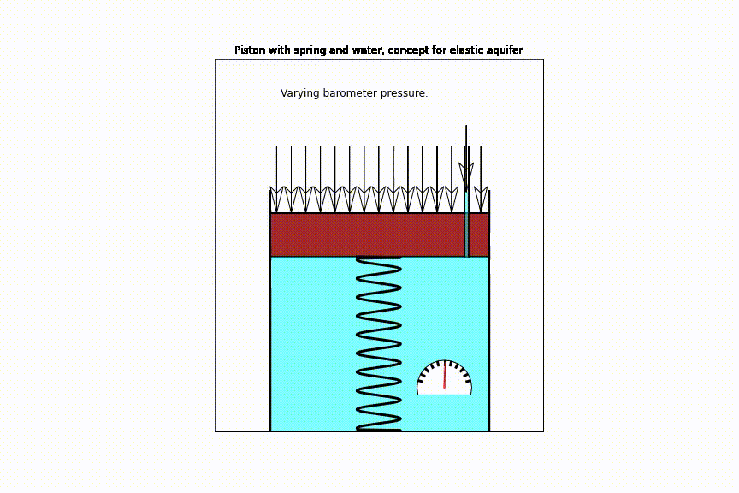

Slide 31
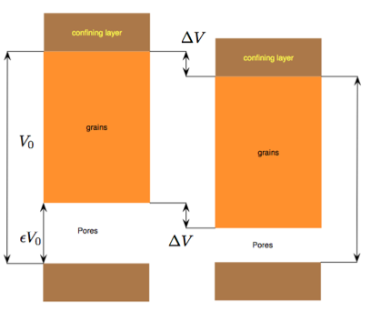
Conceptually split the pore volume from the pure grain volume (virtually uncompressible) and see why the change of aquifer volume equals the change of pore volume.

Slide 32
Pressure changes in and on the ground
Change in overburden (at ground surface)
Loading
Tides (below ocean floor, near coast)
Change in atmospheric pressure
Note: These pressure changes only affect heads in (semi)confined aquifers !

Slide 33
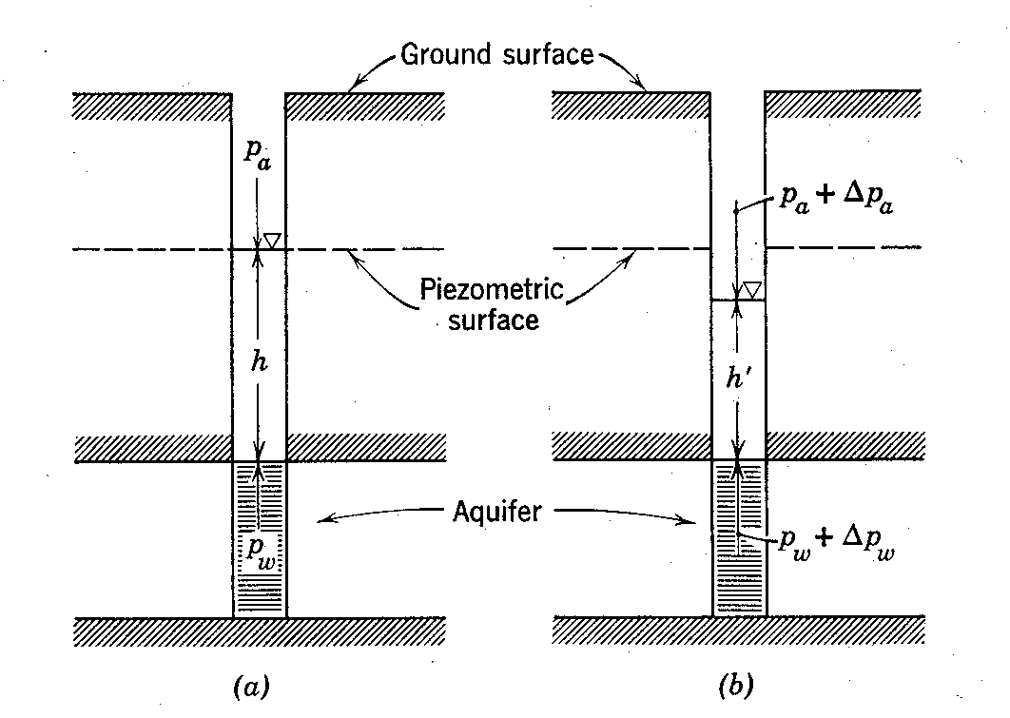
How does the barometer affect head? What’s the difference with loading at ground surface?

Slide 34
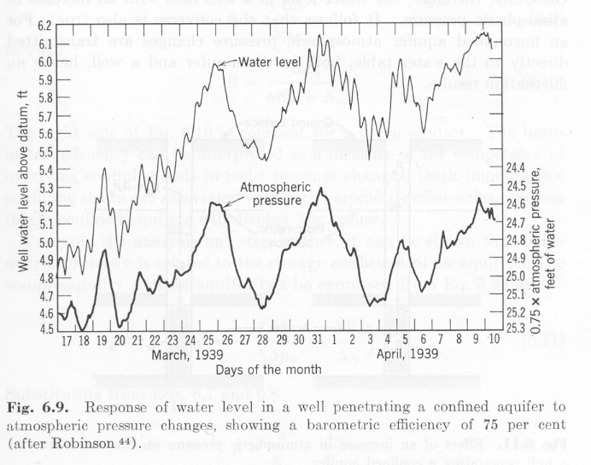
First-ever registration of barometer effect. Notice that the atmospheric axis has been reversed!

Slide 35
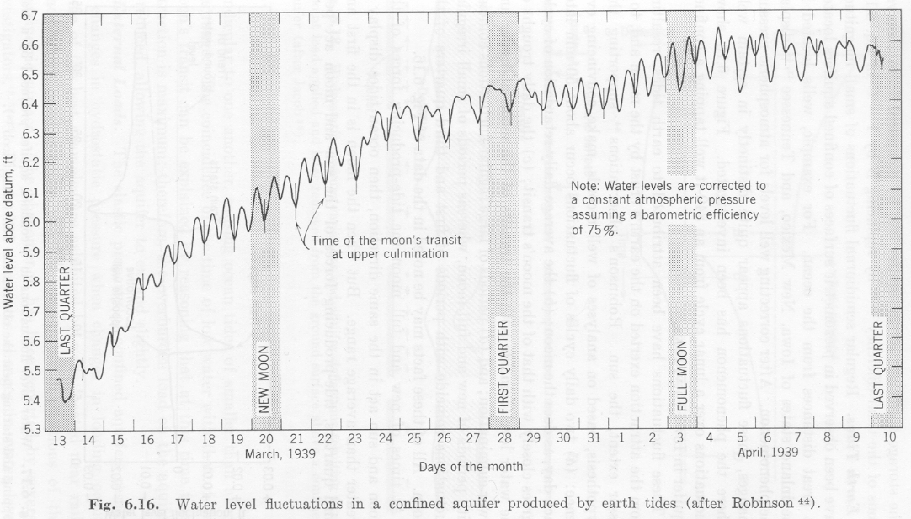
First-ever registered earth tides

Slide 36
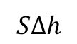
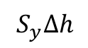
Difference in amount of water drained from a phreatic and and a confined aquifer for the same drawdown
Phreatic aquifer
Confined aquifer
Initial water table
Initial head
Final water table
Drawdown
Final head
impervious
impervious
$$S_{y}Δh$$
Amount drained
$$SΔh$$

Slide 37
Derivation of basic partial differential equation

Slide 38
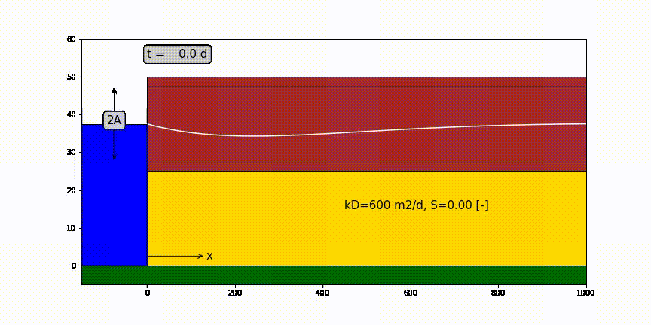
One-dimensional half infinite confined aquifer bounded by surface water at x=0 in which water level fluctuation like a sine.

Slide 39
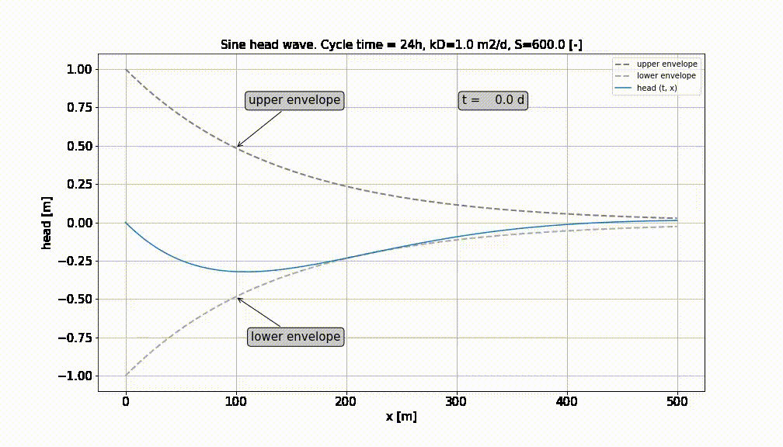

Slide 40
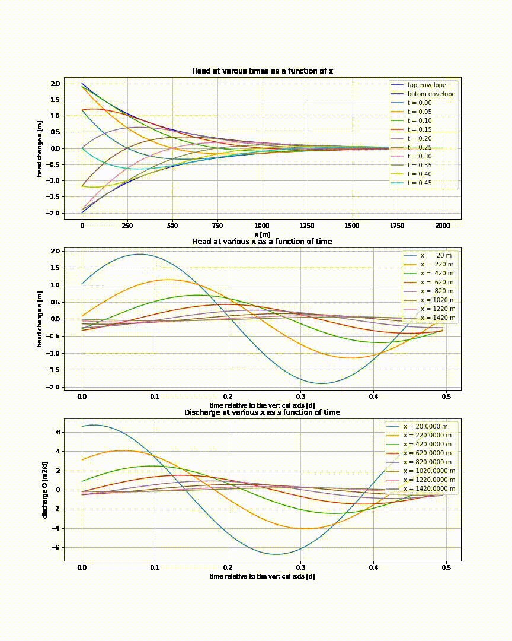

Slide 41
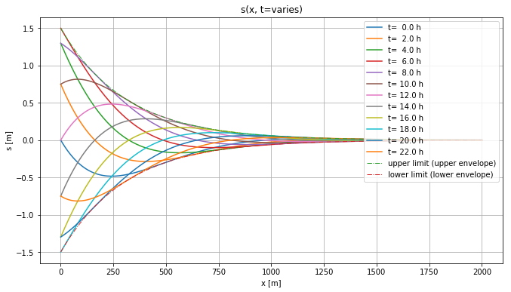
Head in aquifer at different times. Stays within envelopes

Slide 42
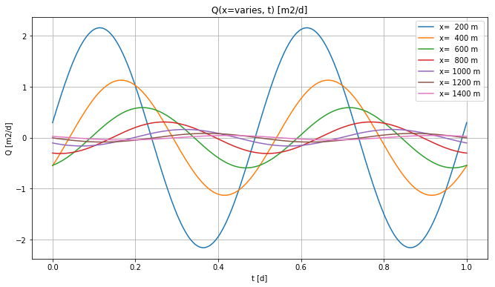
Heads at different x

Slide 43
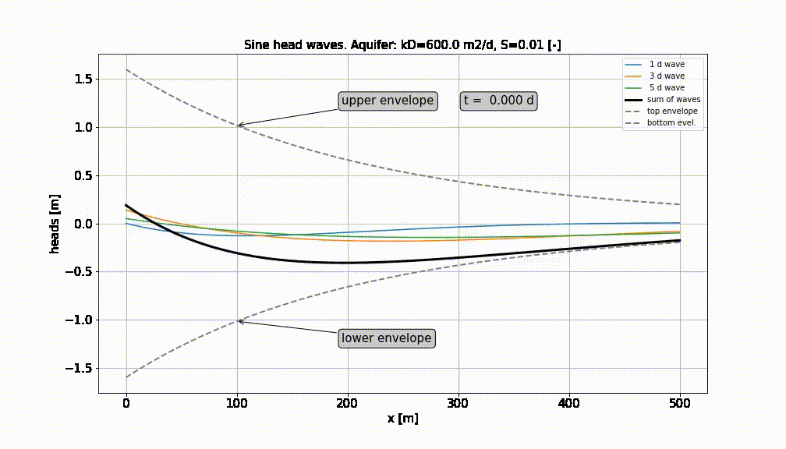
Superpostion of a number of sine-waves

Slide 44
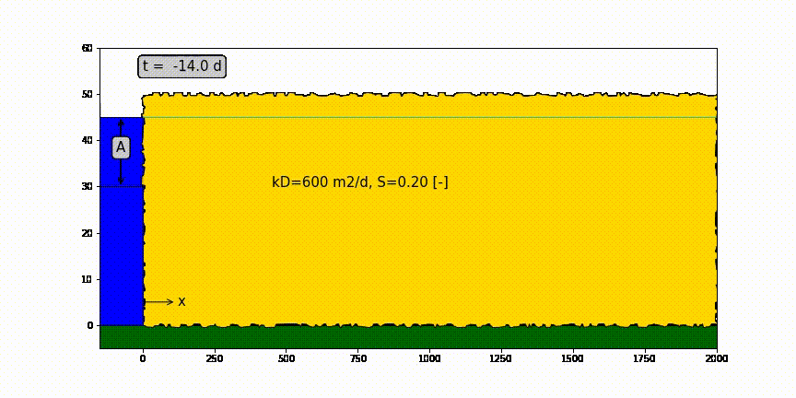
Head change due to sudden head change at x=0

Slide 45
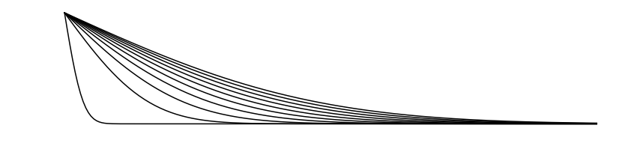
Head change due to sudden head change at x=0
h(x,0)
Drawdown progression
Water table h(x, t) declines with time (= drawdown)
h(x,∞)

Slide 46
Confined aquifer of half-infinite extent with sudden head change A [m] at x=0 and t=0
A
kD
S
x

Slide 47
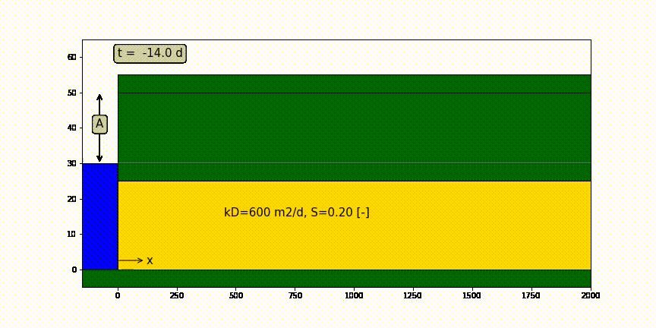
Confined aquifer of half-infinite extent with sudden head change A [m] at x=0 and t=0

Slide 48
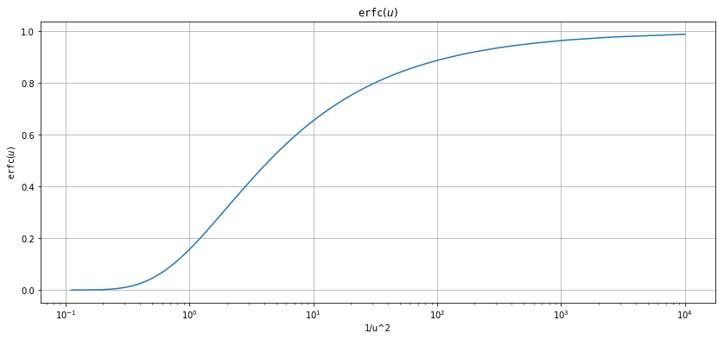
erfc(u) as function of 1/u

Slide 49
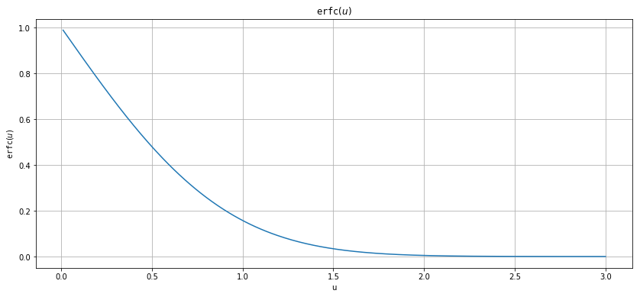
erfc(u) as a function of u

Slide 50
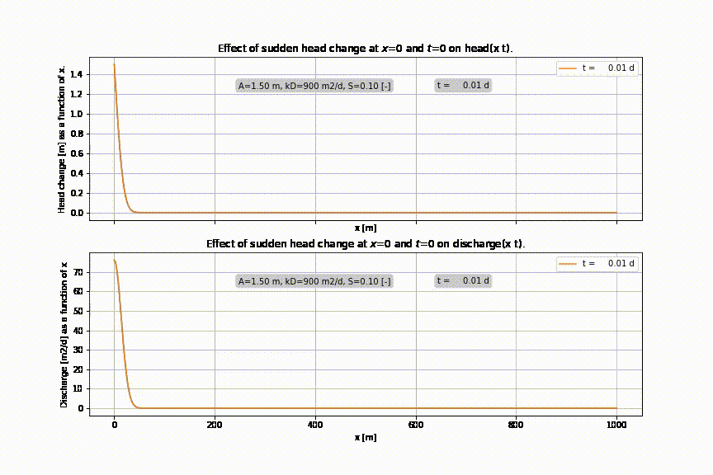

Slide 51
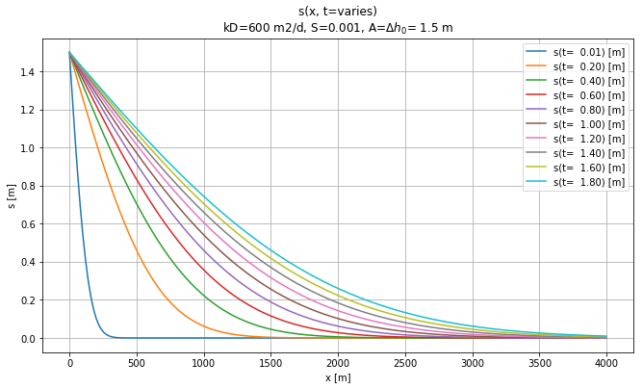
Effect of sudden rise of head at x=0 and t=0

Slide 52
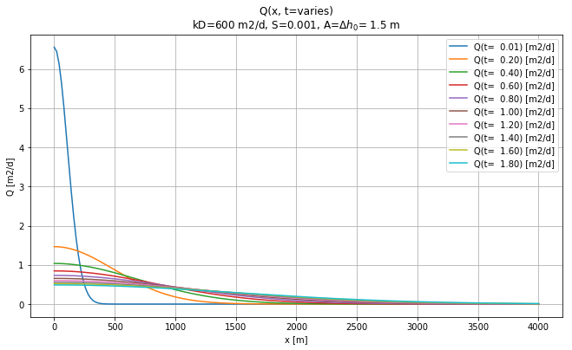
Discharge at different time due to sudden head change at x=0

Slide 53
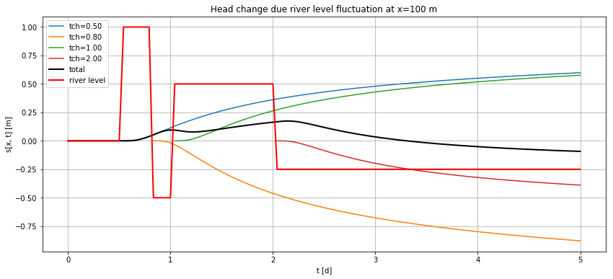
Varying water level at x=0 → do superposition in time

Slide 54
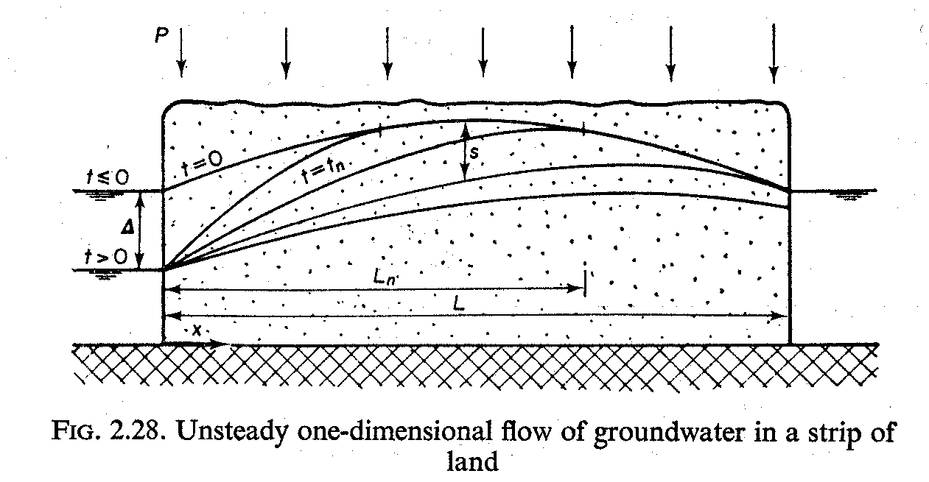
Aquifer is bounded between two fixed-head boundaries, what to do?

Slide 55
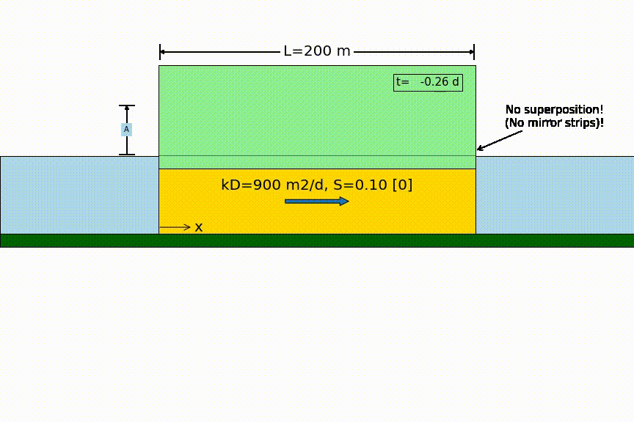
Head changes suddenly on one side

Slide 56
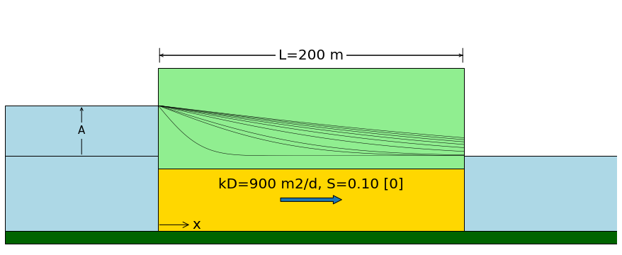
Head changes suddenly on one side
Sudden water level change by A
no longer zero !

Slide 57
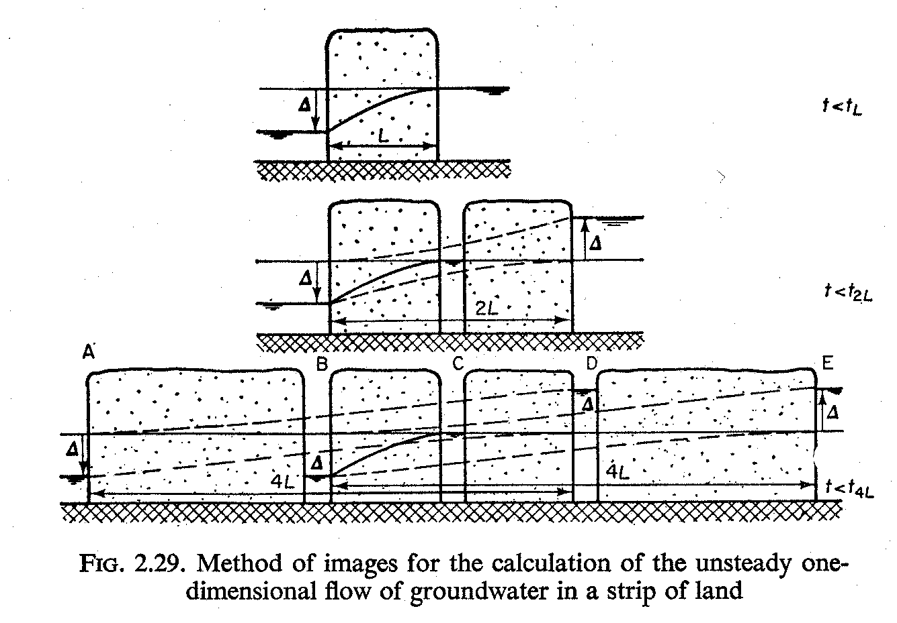
Aquifer is bounded between two fixed-head boundaries→ superposition in space

Slide 58
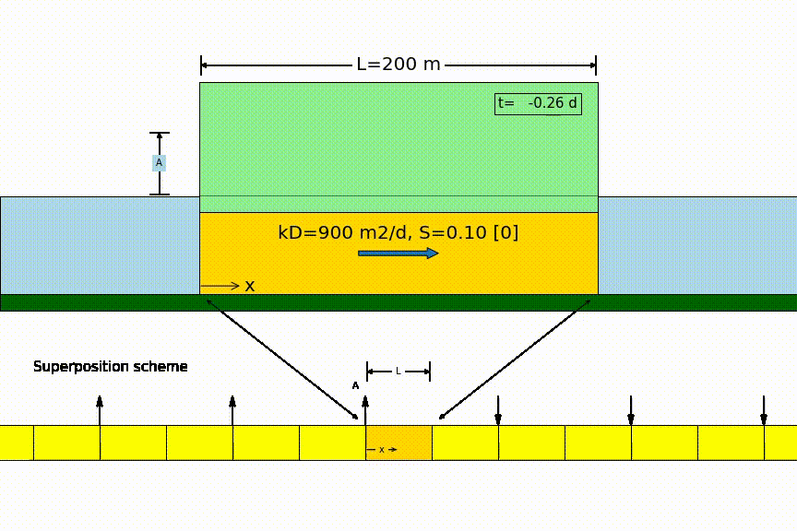
Head changes suddenly on one side

Slide 59
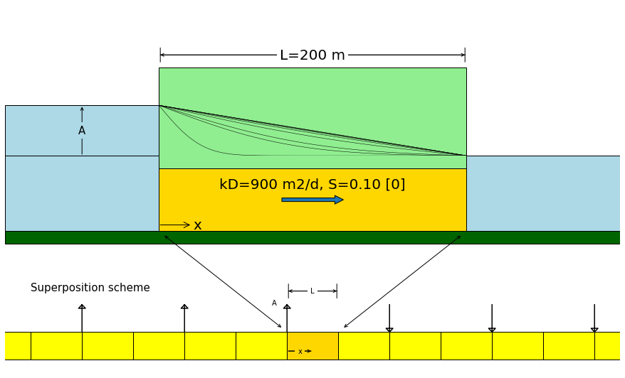
Head changes suddenly on one side
zero

Slide 60
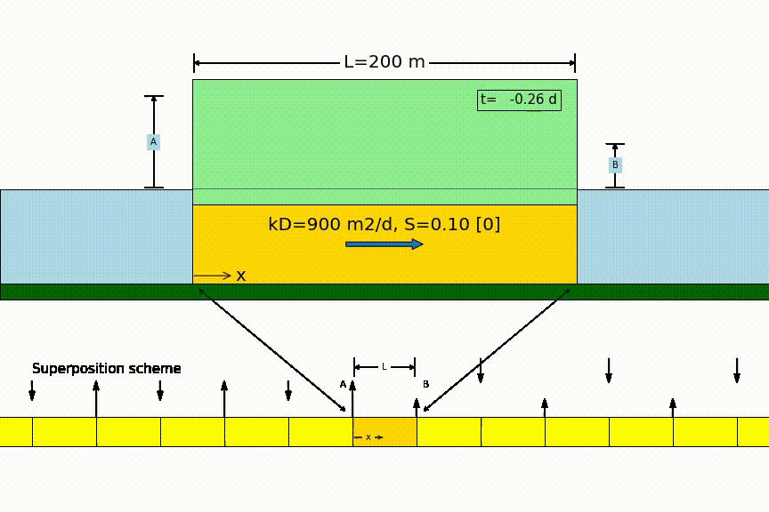
Head changes suddenly on two sides

Slide 61
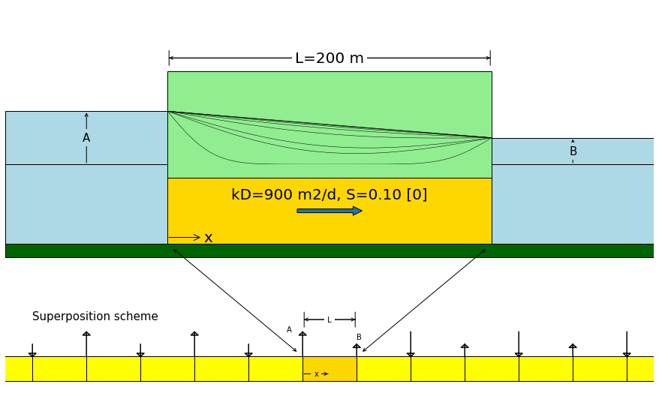
Head changes suddenly on both sides

Slide 62


Slide 63


Head changes suddenly on both sides

Slide 64

Symmetrical same sudden head change on both sides

Slide 65

Strip drainage after sudden recharge

Slide 66


Basin drainage (two methods)

Slide 67


Slide 68


Individual terms of power series solution

Slide 69
How fast or slow is the groundwater system ??

Slide 70
desert
qanat
Mountains
Village with crop fields
qanat
qanat
drainage
area
New development
qanat
Cross section along AA’
Village with
crop fields
qanat
Water-table aquifer
Water table
Bedrock

Slide 71

Example groundwater fluctuation depending on distance to boundary

Slide 72


Slide 73



Slide 74


Slide 75

Precipitation – evapotranspiration (daily figures)

Slide 76
Convolution superposition in the time domain

Slide 77


Slide 78


Slide 79


Slide 80


Slide 81


Slide 82
Examples
Groundwater next to a natural river with fluctuation water level
Head due to time-varying Theis well
Head in a groundwater basin driven by varying recharge

Slide 83


Groundwater next to river
Block responses (d𝜏 = 10 min)
Varying river level with groundwater responses
at different distances from the river

Slide 84


Theis well with varying Q
Time-varying well extraction
Block-responses (d𝜏=1 d), at different distances

Slide 85


Result of Theis well with varying Q, compare with Theis well with average Q
Drawdown on linear time-axis
Drawdown on logarithmic time-axis

Slide 86


Groundwater head in land between rivers under varying recharge
Daily recharge figures
Response in 400 m wide basin

Slide 87


Response in 1500 m wide basin
Response in 4000 m wide basin

Slide 88



Block responses d𝜏 = 1d
Basin is 400 m wide
Basin is 1500 m wide
Basin is 4000 m wide

Slide 89
Groundwater flow solutions are often step responses
See the two examples we had before:
Sudden change of river level
Sudden start of pumping a well

Slide 90
Step response
Head,
Concentration,
Temperature
or whatever
t

Slide 91
Transient flow to wells

Slide 92


Slide 95
Q
s
c
kH
S
r

Slide 96
Q
s
S_{y}
h
k
r

Slide 97
arbitrary datum

Slide 99
Exercise
Drawdown by for wells in a square with sides of L = 1 km
Task
First well starts at t=0 d
Second wel at t = 365 d
Third well at t = 730 d
Fourth well at 1095 d
kD = 600 m2/d
Sy = 0.24
Q = 14400 m3/d
Compute and show the drawdown in the center of the square as a function of time up to t=10 years.
Compute and show the drawdown on a grid as contour lines

Slide 100
Well1 (14400 m³/d from t=0)
Well2 (14400 m³/d from t=365 d)
1000 m
Well4 (14400 m³/d from t=1095 d)
Well3 (14400 m³/d from t=730 d)
1000 m

Slide 101

Drawdown in the center of the square over time

Slide 102

Drawdown contours

Slide 103


Slide 104
Excercise
Properties
Task
5 wells in a row at x=0 and y = [-180, -80, 0, 80, 160] m extracting 240 m3/d each.
kD = 600 m²/d
S_{y} = 0.22
c = 200 d
Compute the drawdown along the xaxis (y=0) for several times up to 1000 d
First using Theis drawdown
Second using Hantush

Slide 105


Slide 106


Slide 107

Match point

Slide 108

Match point

Slide 109
Match point

Slide 110



Slide 111


Slide 112


Slide 113
Hantush (1956)
Transient radial symmetric flow towards a well
in a semi-confined aquifer
Q
φ
s=φ-φ_{o}
φ_{o}
c
kD
λ²=kDc

Slide 114
Measuring from above
Measuring from below
b
a
z
D
a
r
r
b
z

Slide 115
r_{c}
k
r_{w}
h
r

Slide 116
Key questions
Can you derive the elastic storage coefficient of aquifers?
Same for barometric efficiency?
Same for effect of overburden change?
How do barometric efficiency and overburden efficiency relate to each other?
How can specific storage coefficient be derived from measured barometric efficiency?
How does specific storage relate to elastic storage of an aquifer?
Have any idea of values of specific storage found in practice?
Same for specific yield of sand?
What is the dimension of specific yield S_{y}, specific storage S_{s} and elastic storage S?
Which of the two is largest (specific yield or elastic storage, and how much larger?)
For the cracks: could you derive the effect of earth tide on groundwater head?

